Slide 1
CS 4215: Quantitative Performance Evaluation for Computing ystems
Lydia Y. Chen
y.chen-10@tudelft.nl

Slide 4
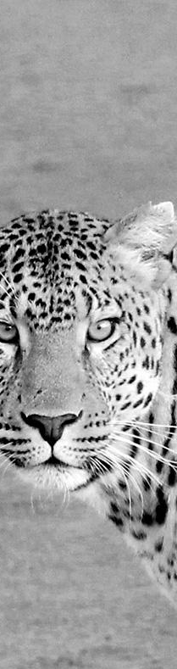
Hello!
I am Jayden Smith
Characterization
Modeling
Predicting
Resource managment

Slide 5
Data-driven models

Slide 6
Overview of methodologies

Slide 7
This is a slide title
Logistic regression
Discriminant analysis
Decision tree
Random forest
Support vector machine
Simple neural network

Slide 8

Examples

Slide 9
Reliability: probabilistic models

Slide 10
Examples

Slide 11
Reliability: statistical models

Slide 12

Classification Example: Email Spam
Observe the set of all possible emails (strings)
Check if new email is the set is spam or non-spam
From: medshop@spam.com Subject: Viagra cheap meds... From: my.instructor@Zurich.ibm.com Subject: important information here's how to ace the test... | Spam No-spam
From: mike@example.org Subject: you need to see this how to win $1,000,000... | ???

Slide 13

Classification: Credit Card Fraud
Observe the set of old transactions
Check if new transactions are fraud or normal
Cash advance $1,000 Cash advance $10,000 Flight out of the country $1,200 Candy bar $1.20 Groceries $67.10 Restaurant $35.82 ……. ... | Fraud Normal
Flight out of the country $380 Hotel booking $210 Groceries $69.20 | ???

Slide 14

Classification Example: Diabetes Diagnoses
Server utilization Memory utilization 60 Number of task Patient Bob Age 30 Blood pressure 120 mmHG Weight 70 kg ……. ... | Will fail Will not fail Diabetes
Patient Maira Age 55 Blood pressure 150 mmHG Weight 60 kg | ???

Slide 15
Definition of Classification Problem
Input X
One to multiple
E.g., age, blood pressure, and weight
Output Y (Class outcome)
Binary (y=1 or -1) or multiple classes (G=1,2,..k)
E.g., the sign of diabetes or not
Objective:
Optimize the conditional probability of data set,
Max Pr (G=k | X=x)

Slide 16
How to Build Classifier
Making assumptions about the data structure
Choose a classifier, e.g., linear v.s. nonlinear, generative v.s. discriminant
Parameterize (fit) the model, involving an optimization procedure
Classify the new data (inference)

Slide 17
Classification Algorithms
Logistic regression
Linear Discriminant analysis
Expanded linear discriminant analysis
Quadratic Discriminant analysis
Discriminative v.s. Generative Analysis
Discriminative models P(Y|X) directly and generative models P(X), P(Y)
Generative

Slide 18
Classification Algorithms
Logistic regression (Discriminative)
Linear Discriminant analysis (Generative)
Expanded linear discriminant analysis
Quadratic Discriminant analysis (Generative)
Discriminative v.s. Generative Analysis

Slide 19
Linear Classification
What is meant by linear classification?
The decision boundaries in the in the feature (input) space is linear
May seem ‘too simple’, but in high-dimensions it is surprisingly powerful
training example of class
+1 training example of class –1
linearly non-separable linearly separable

Slide 20
Linear classification: Definition
Training data (x_{i} , y_{i} )for i = 1, . . . , N, and we wish to predict y ′ corresponding to new data vectors x′
x_{i} ∈ R^{n} (can also be discrete), y_{i} ∈ {−1, 1}
(Note: binary class, but using {−1, 1} instead of {0, 1})
Predicted value yˆ is given by taking the sign of a linear function of the input:
yˆ = sign(w^{T} x),
if z= ≥ 0
sign(z ) = ^{+1,}
−1, if z < 0

Slide 21
Logistic Regression

Slide 22
Logistic Regression
Classification based on probability
Instead of just predicting the class, give the probability of the instance being that class
Directly learn conditional probability Pr (G=k | X=x)= P_{θ}(x)
Focus on binary classification
Example: Cancer diagnosis from tumor size
1
Tumor Size
x = ^{ x0} =
x
P_{θ}(x) = 0.7
→ Patient that 70% chance of tumor being malignant

Slide 23
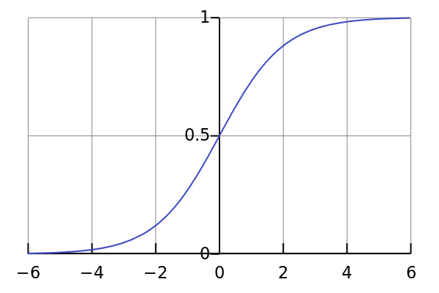



Probability to Classification
Logistic / Sigmoid Function
g(z)
Logistic regression model, assumes
P_{θ}(x) = g (θ|x)
g(z) = _{1 + e−z}
1
Assume a threshold and...
Predict y = 1 if P_{θ}(x) ≥ 0.5
Predict y = 0 if P_{θ}(x) < 0.5
y = 1
θ
y = 0
6

Slide 24
Assumptions
Logistic / Sigmoid Function
g(z)
Logistic regression model, assumes
h_{θ}(x) = g (θ|x)
g(z) = _{1 + e−z}
1
1
_{1 + e}−θ^{T}x
h_{θ}(x) =
_{log} p(y = 1 | x; θ)
_{p(y = 0 | x; θ)} = θ₀ + xθ₁x₁ + .. . + θ_{d}x_{d}

Slide 25
Assumptions
Logistic / Sigmoid Function
g(z)
Logistic regression model, assumes
h_{θ}(x) = g (θ|x)
g(z) = _{1 + e−z}
1
1
_{1 + e}−θ^{T}x
h_{θ}(x) =
_{log} p(y = 1 | x; θ)
_{p(y = 0 | x; θ)} = θ₀ + xθ₁x₁ + .. . + θ_{d}x_{d}
In other words, logistic regression assumes that the log odds is a linear function of
odds of y = 1

Slide 26
Comparison with LR on Indicators
Similarities:
Both attempt to estimate Pr (G = k | X = x ).
Both have linear classification boundaries.
Differences:
Linear regression on indicator matrix: approximate
Pr (G = k | X = x ) by a linear function of x .
Pr (G = k | X = x ) is not guaranteed to fall between 0 and 1 and to sum up to 1.
Logistic regression: Pr (G = k | X = x ) is a nonlinear function of x . It is guaranteed to range from 0 to 1 and to sum up to 1.

Slide 27
Fitting Logistic Regression
Criteria: find parameters that maximize the conditional likelihood of G given X using the training data.
Denote p_{k} (x_{i} ; θ) = Pr (G = k | X = x_{i} ; θ).
Given the first input x₁, the posterior probability of its class being g₁ is Pr (G = g₁ | X = x₁).
Since samples in the training data set are independent, the posterior probability for the N samples each having class g_{i} , i = 1, 2, ..., N, given their inputs x₁, x₂, ..., x_{N} is:

Slide 28
Conditional Likelihood
The conditional log-likelihood of the class labels in the training data set is

Slide 29
Derivation of L(θ)
For binary classification, if g_{i} = 1, denote y_{i} = 1; if g_{i} = 2, denote y_{i} = 0.
Let p₁(x ; θ) = p(x ; θ), then
p₂(x ; θ) = 1 − p₁(x ; θ) = 1 − p(x ; θ) .
Since K = 2, the parameters θ = {β₁₀, β₁}. We denote β = (β₁₀, β₁)^{T} .

Slide 30
Derivation L(θ)
If y_{i} = 1, i.e., g_{i} = 1,
log p_{gi} (x ; β)
= log p₁(x ; β)
= 1 · log p(x ; β)
= y_{i} log p(x ; β) .
If y_{i} = 0, i.e., g_{i} = 2,
log p_{gi} (x ; β) =
=
=
log p₂(x ; β)
1 · log(1 − p(x ; β))
(1 − y_{i} ) log(1 − p(x ; β)) .
Since either y_{i} = 0 or 1 − y_{i} = 0, we have
log p_{gi} (x ; β) = y_{i} log p(x ; β) + (1 − y_{i} ) log(1 − p(x ; β)) .

Slide 31
Binary Classifier
The conditional likelihood
There p +1 parameters in β = (β₁₀, β₁)^{T}
Assume a column vector form for β:

Slide 32
T
exp(β x )
p(x ; β) = Pr (G = 1 | X = x ) =
1 + exp(β^{T} x )
1
1 − p(x ; β) = Pr (G = 2 | X = x ) =
1 + exp(β^{T} x )
By the assumption of logistic regression model
Substitute the above in L(β):

Slide 33
Solving

Slide 34
Example
Diabetes data set
Input X is two dimensional. X₁ and X₂ are the two principal components of the original 8 variables.
Class 1: without diabetes; Class 2: with diabetes.
Applying logistic regression, we obtain
β = (0.7679, −0.6816, −0.3664)^{T} .

Slide 35
Example
◮ The posterior probabilities are:
_{e}0.7679−0.6816X1−0.3664X2
_{1 + e}0.7679−0.6816X1−0.3664X2
Pr (G = 1 | X = x ) =
1
_{1 + e}0.7679−0.6816X1−0.3664X2
Pr (G = 2 | X = x ) =
◮ The classification rule is:
G^{ˆ} (x ) = ¹
0.7679 − 0.6816X₁ − 0.3664X₂ ≥ 0
2 0.7679 − 0.6816X₁ − 0.3664X₂ < 0

Slide 36
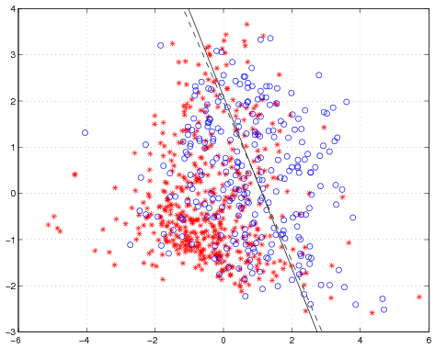
Solid line: decision boundary obtained by logistic regression. Dash line: decision boundary obtained by LDA.

Slide 37
Discriminant Analysis

Slide 38
Bayes Basics
The prior probability of class k is π_{k}
π_{k} is usually estimated simply by empirical frequencies of the training set
The class-conditional density of X in class G = k is f_{k} (x ).
Compute the posterior probability
Obtain classifier By MAP (the Bayes rule for 0-1 loss)

Slide 39
Linear Discriminant Analysis
Assumption 1: Multivariate Gaussian
Assumption 2: Σ_{k} = Σ, ∀k.
The Gaussian distributions are shifted versions of each other.

Slide 40
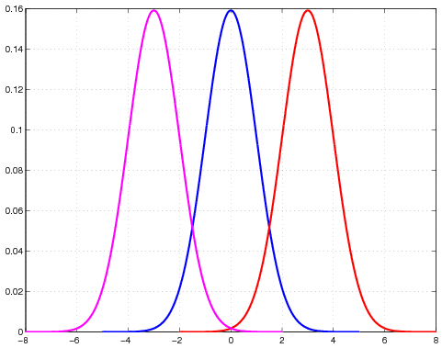
Linear Discriminant Analysis

Slide 41
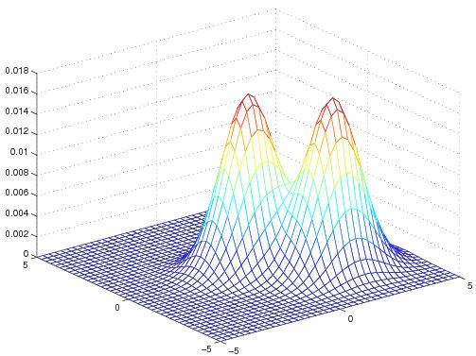
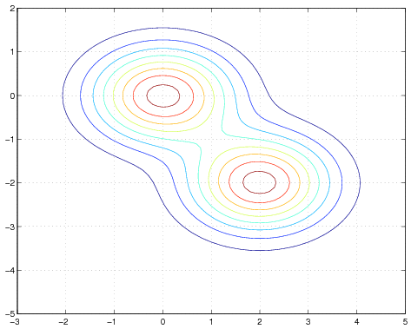
Linear Discriminant Analysis

Slide 42
Optimal Classifier, G^{ˆ} (x )
G^{ˆ} (x )
= arg max Pr (G = k | X = x)
k
=
arg max f_{k} (x )π_{k} = arg max log(f_{k} (x)π_{k} )
k k
= arg max [ -log((2π)^{p/2}|Σ|^{1/2})
k
— (x − µ_{k} )^{T} Σ(x − µ_{k} ) + log(π_{k} ) ]
= arg max [-(x − µ_{k} )^{T} Σ (x − µ_{k} ) + log(π_{k} ) ]
k

Slide 43
Derivation of Optimal Classifier
Define the linear discriminant function
Then Classification rule
The decision boundary between class k and l is:
Or equivalently the following holds

Slide 45
An Numerical example
Binary classification (k = 1, l = 2)
Classify to class 1 if a+ Σ a_{j} x_{j} >0; to class 2 otherwise
Example,
π1 = π2 = 0.5, µ1 = (0, 0)^{T} , µ2 = (2, −2)^{T,}
Σ
Decision boundary:
5.56 − 2.00 X1 + 3.56X2 = 0.0

Slide 46
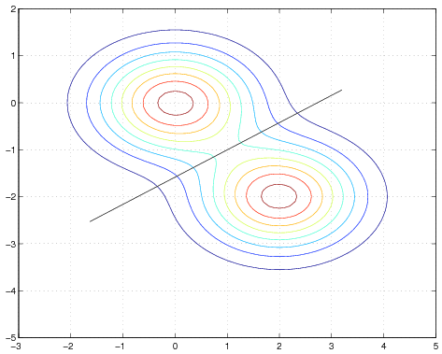

Slide 47
Estimating Gaussian Distributions
Maximum likelihood Estimate
N_{k} is the number of class-k samples,
x ^{(i )} denotes the i th sample vector

Slide 48
Diabetes Data Set
Two input variables computed from the principal components of the original 8 variables.
Prior probabilities: πˆ₁ = 0.651, πˆ₂ = 0.349.
Classification rules:
_{Σˆ =} 1.7925 −0.1461
−0.1461 1.6634

Slide 49

The scatter plot follows. Without diabetes: stars (class 1), with diabetes: circles (class 2). Solid line: classification boundary obtained by LDA. Dash dot line: boundary obtained by linear regression of indicator matrix.
The scatter plot follows. Without diabetes: stars (class 1), with diabetes: circles (class 2). Solid line: classification boundary obtained by LDA. Dash dot line: boundary obtained by linear regression of indicator matrix.

Slide 50
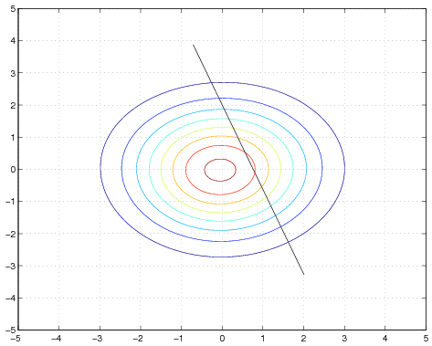
Contour

Slide 51
Poor results of LDA
LDA is not necessarily bad when the assumptions about the density functions are violated.
In certain cases, LDA may yield poor results.

Slide 52
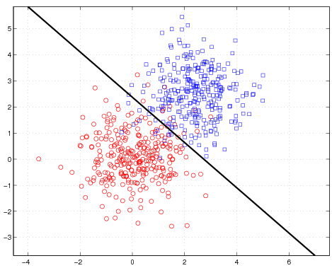
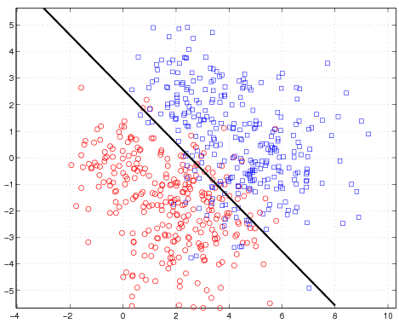
Linear Discriminant Analysis
Poor results of LDA
Left: The true within class densities are Gaussian with identical covariance matrices across classes. Right: The true within class densities are mixtures of two Gaussians

Slide 53
Quadratic Discriminant analysis
Estimate the covariance matrix Σ_{k} separately for each class k, k = 1, 2, ..., K .
Quadratic discriminant function:
Classification rule:
Decision boundaries are quadratic equations in x .
QDA fits the data better than LDA, but has more parameters to estimate.

Slide 54
Diabetes Data Set
Prior probabilités: πˆ₁ = 0.651, πˆ₂ = 0.349.
µˆ₁ = (−0.4035, −0.1935)^{T} , µˆ₂ = (0.7528, 0.3611)^{T}
_{Σˆ =} 1.6769 -0.1461
−0.1461 1.5964
_{Σˆ =} 2.0087 -0.3330
-0.3330 1.7887

Slide 55
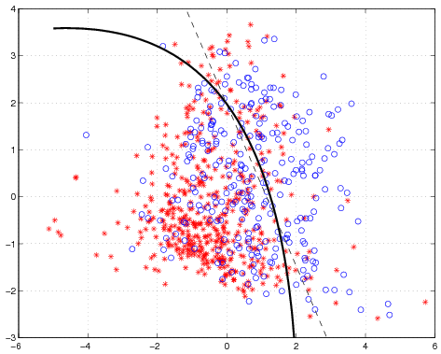

Slide 56
LDA on Expanded Bases
Expand input space to include X₁X₂, X ², and X ².
Input is five dimensional: X = (X₁, X₂, X₁X₂, X ², X ²).

Slide 57
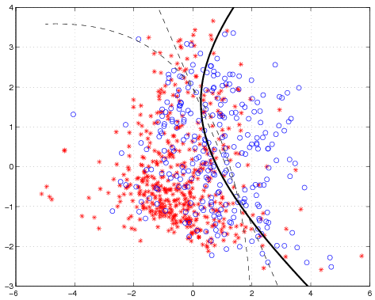
Classification boundaries obtained by LDA using the expanded input space X₁, X₂, X₁X₂, X ², X ². Boundaries obtained by LDA and QDA

Slide 58
Other Learning Approaches
e Rule based methods
e Decision Tree
e Random Forest
e Perceptron methods
e Support Vector Machines
e Neural Networks

Slide 59
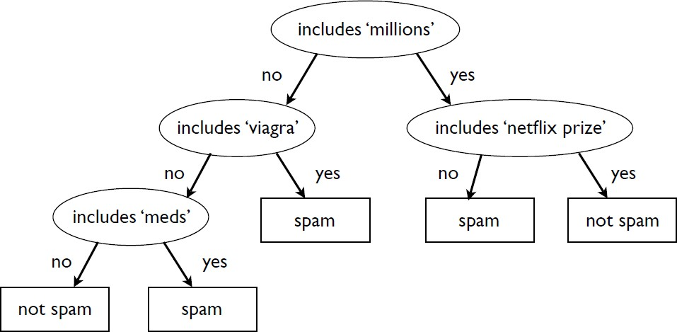
Decision Tree
e Idea: Ask a sequence of questions (as in the ‘20 questions’ game) to infer the class

Slide 60
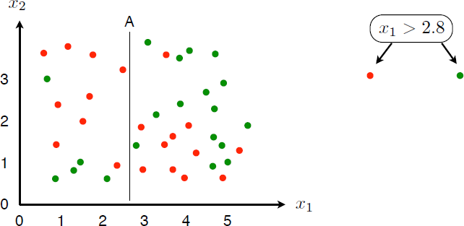
Decision Tree: General IdeasI
e Simple idea: recursively divide up the space into pieces which are as pure as possible

Slide 61
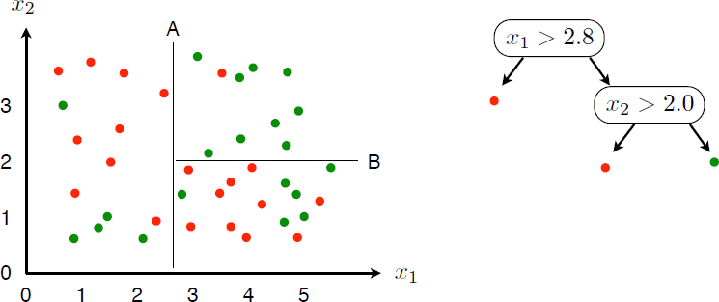
Decision Tree: General IdeasII

Slide 62
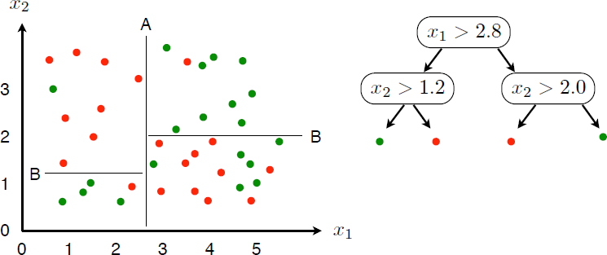
Decision Tree: General IdeasIII

Slide 63
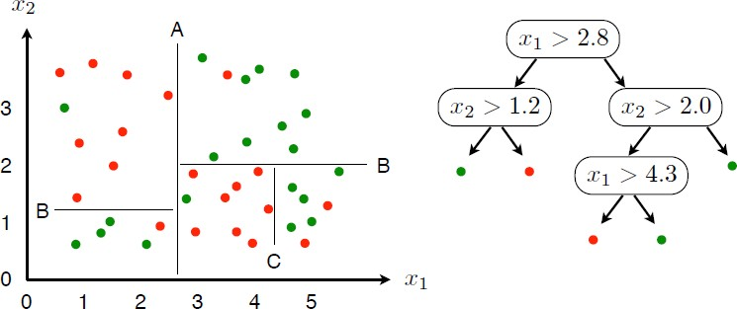
Decision Tree: General IdeasIV

Slide 64
Decision Tree: General Ideas
e Key steps to build the tree
1.A goodness of split criterion that can be evaluated for any split s of any node.
2.A stop-splitting rule.
3.A rule for assigning every terminal node to a class.
e How to measure if a subset of records is ’pure’ or ’impure’
e Entropy
e Gini index
e Classification error

Slide 65
Characteristics of Decision Tree
e Nonparametric approach
e Can approximate any decision boundary (hyper plane) to arbitrary precision
e A practical starting point
e Local, greedy learning to find a reasonable solution in reasonable time
e Relatively easy to interpret (by experts or regular users of the system)
e Data fragmentation problem: the nodes far down the tree are based on a very small fraction of the data, even only on a few data points ) typically not very reliable information

Slide 66
Random Forest

Slide 67
Support Vector Machine
e Construct linear decision boundaries that explicitly try to separate the data into different classes as well as possible.
e Good separation is defined in a certain form mathematically.
e Even when the training data can be perfectly separated by hyperplanes, LDA or other linear methods developed under a statistical framework may not achieve perfect separation.

Slide 68
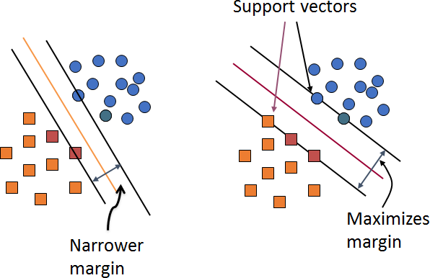
Optimal Separating Hyperplane
e The optimal separating hyperplane separates the two classes and maximizes the distance to the closest point from either class.

Slide 69
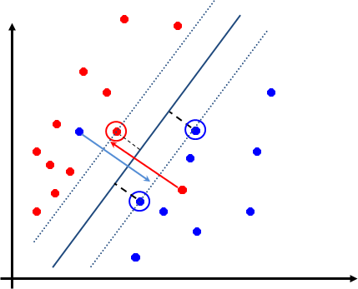
Key Ideas of SVM
e Seek large margin separator to improve generalization
e Use optimization to find optimal hyperplane with few errors via slack variables

Slide 71
Anomaly detection

Slide 72
Thanks!
Any questions?
You can find me at:
@username
user@mail.me

Slide 73
Bonus quiz

Slide 74
Next lecture:

Slide 75
Thanks!

Slide 76
Credits
Special thanks to all the people who made and released these awesome resources for free:
Presentation template by SlidesCarnival
Photographs by Unsplash

Slide 77
Presentation design
This presentations uses the following typographies and colors:
Titles: Raleway
Body copy: Lato
You can download the fonts on these pages:
https://www.fontsquirrel.com/fonts/raleway
https://www.fontsquirrel.com/fonts/lato
Dark blue #2185c5
Light blue #7ecefd
Yellow #ff9715
Magenta #f20253
Dark gray #677480
Light gray #97abbc
You don’t need to keep this slide in your presentation. It’s only here to serve you as a design guide if you need to create new slides or download the fonts to edit the presentation in PowerPoint®

Slide 78
SlidesCarnival icons are editable shapes.
This means that you can:
Resize them without losing quality.
Change fill color and opacity.
Change line color, width and style.
Isn’t that nice? :)
Examples:

Slide 79
😉
Now you can use any emoji as an icon!
And of course it resizes without losing quality and you can change the color.
How? Follow Google instructions https://twitter.com/googledocs/status/730087240156643328
✋👆👉👍👤👦👧👨👩👪💃🏃💑❤😂😉😋😒😭👶😸🐟🍒🍔💣📌📖🔨🎃🎈🎨🏈🏰🌏🔌🔑 and many more...

